Slide 1
The Bible tells us of lots of stories about times when people
had experiences of God
Notes:
1. The Bible tells us lots of stories about times when people had experiences of God.

Slide 2
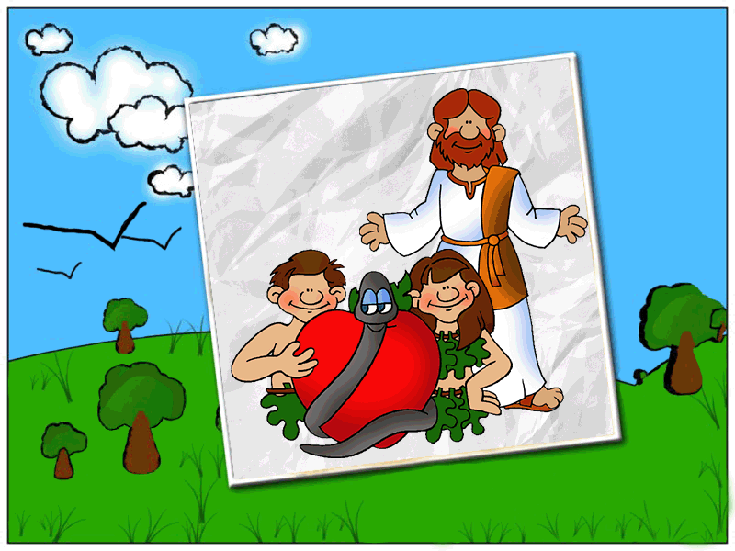
Adam and Eve walked with
God in the garden each afternoon
Notes:
2. Adam and Eve walked with God in the garden each afternoon.

Slide 3
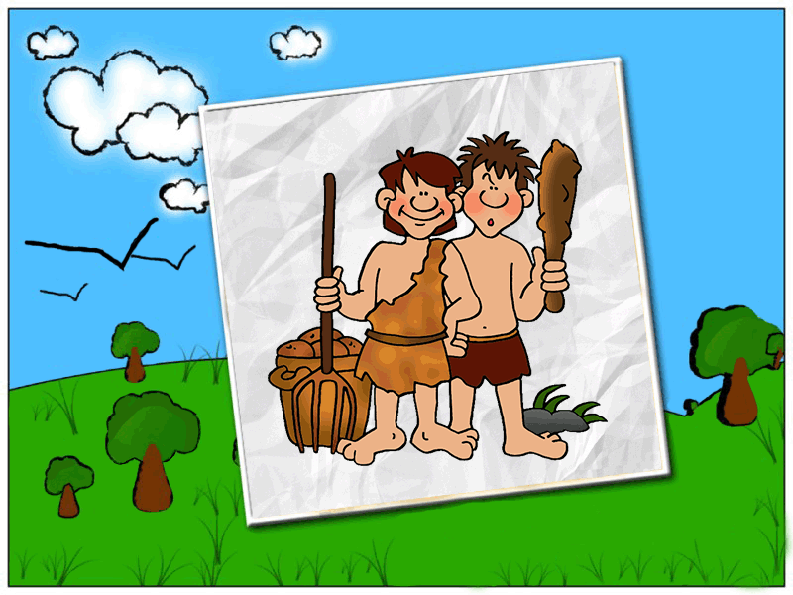
Cain talked with God
about his tough judgement
Notes:
3. Cain talked with God about his tough judgement.

Slide 4
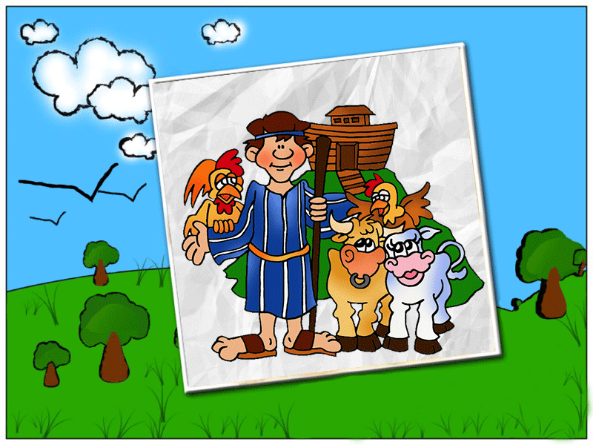
Noah walked with God
Notes:
4. Noah walked with God.

Slide 5
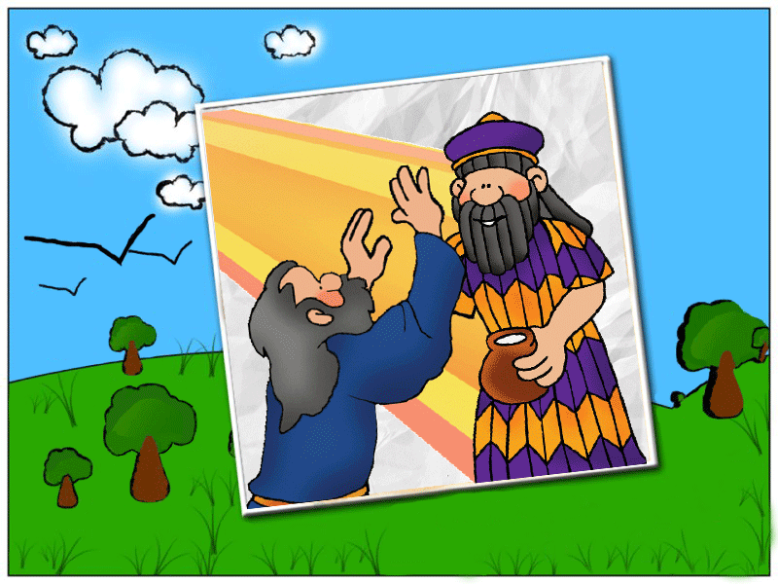
Pharaoh received messages
from God through Moses
Notes:
Pharaoh received messages from God through Moses.

Slide 6
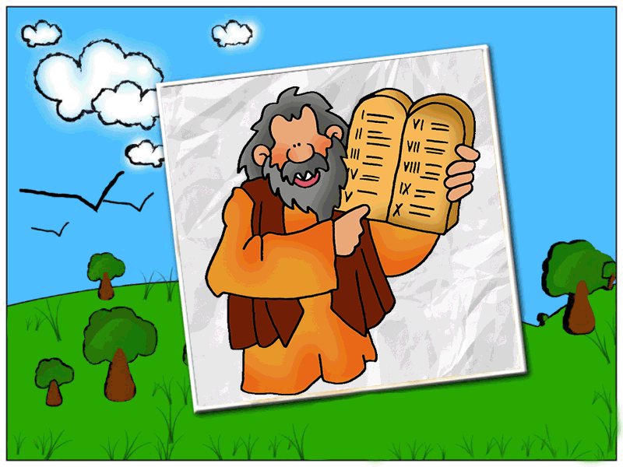
When God gave Moses The 10 Commandments,
he saw God’s hand and it turned his hair white
Notes:
6. When God gave Moses the 10 commandments, he saw God’s hand and it turned his hair white.

Slide 7
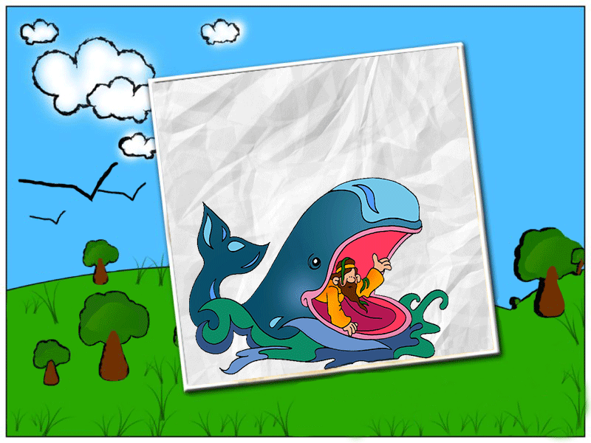
Jonah didn’t respond
well to God
Notes:
7. Jonah didn’t respond well to God.

Slide 8
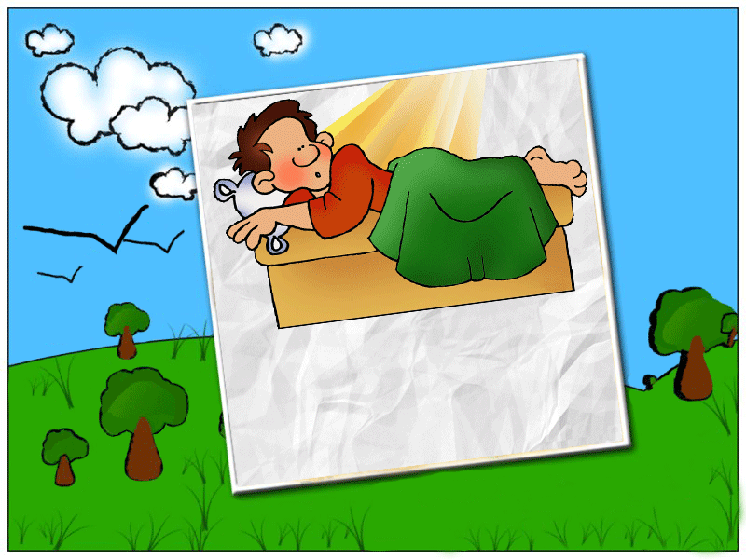
Joseph had dreams
that revealed God’s plan
Notes:
8. Joseph had dreams that revealed God’s plans.

Slide 9
Daniel saw the hand of
God revealing judgement
Notes:
9. Daniel saw the hand of God revealing judgement.

Slide 10
God spoke
to Zechariah
Notes:
10. God spoke to Zechariah in the temple about the birth of his son (John the Baptist).

Slide 11
God sent His messenger an Angel to Mary to speak to her about her pregnancy and the birth of Jesus
Notes:
11. God sent his messenger, an Angel to Mary to speak to her about her pregnancy and the birth of Jesus.

Slide 12
Lots of people met Jesus, God’s son
Notes:
12. Lots of people met Jesus, God’s son.

Slide 13
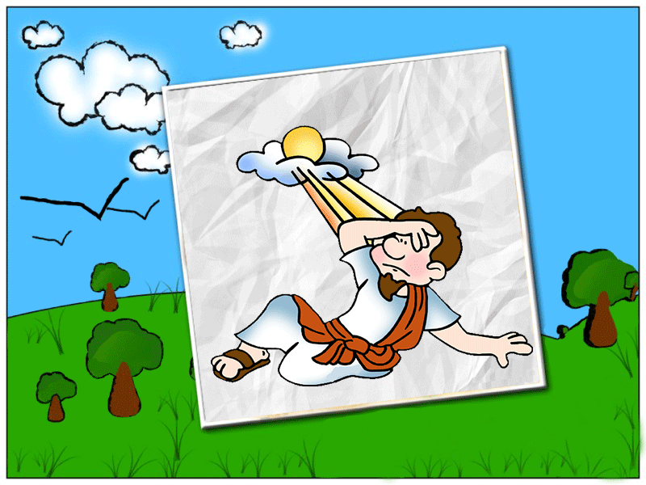
Paul heard Jesus speak to him on the
road to Damascus and it changed his life
Notes:
13. Paul heard Jesus speak to him on the road to Damascus and it changed his life.

Slide 14
What about YOU?
Notes:
14. What about You?

Slide 15
PowerPoint created by The Salvation Army
Children’s Ministries – Australia Eastern Territory
Biblical Illustrations by Philip Martin

